Slide 1
WebKit JavaScript Engine optimizations
By Kiril Knysh

Slide 2



















Why WebKit?

Slide 3



Why WebKit?
+

Slide 4


Why WebKit?

Slide 5
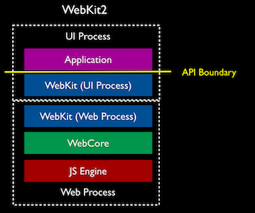
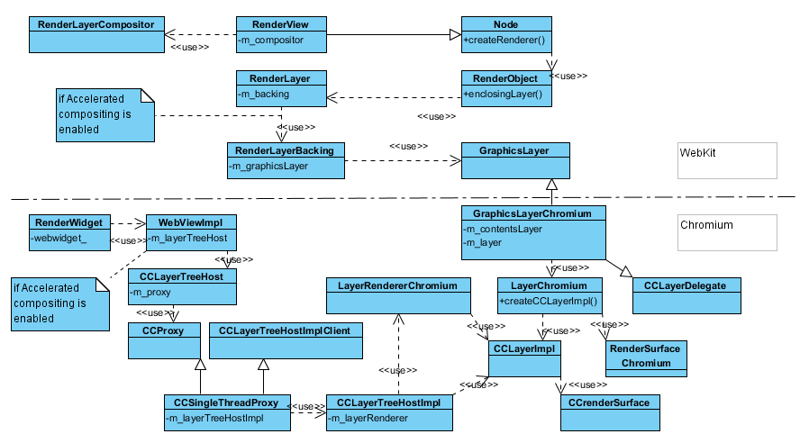
What is WebKit JavaScriptCore

Slide 6
WebKit JavaScriptCore overview
LLInt
100 x statement execution
6 calls
Baseline JIT
1000 x statement execution
66 calls
DFG JIT

Slide 7
WebKit JavaScriptCore overview DFG JIT optimizations
Type prediction
Dead-code elimination
Register allocation optimization
function sum(a, b) {
return a + b;
}
If a NOT integer -> back to Baseline JIT
If b NOT integer -> back to Baseline JIT
result = a + b
If overflow -> back to Baseline JIT
Common subexpression elimination
Constant propagation

Slide 8
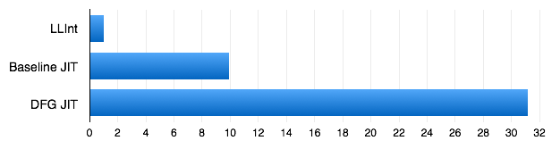
WebKit JavaScriptCore overview
Tiers speed-up
(OS simulation by Martin Richards benchmark)
Higher is better

Slide 9
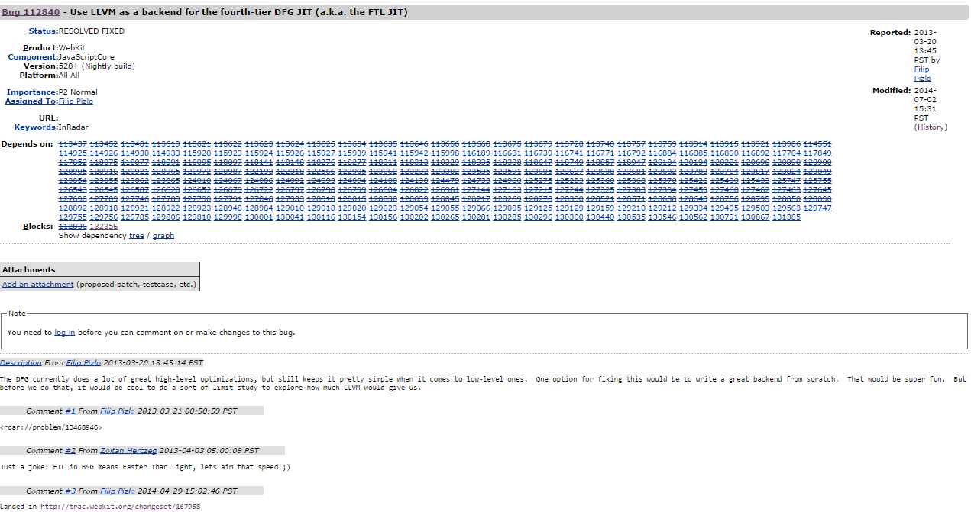
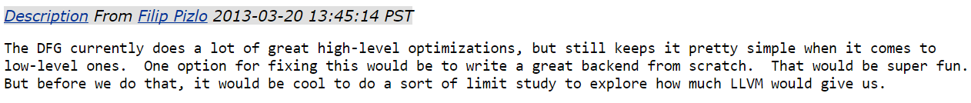

29 Apr 2014

Slide 10

FTL JIT
Faster Than Light
Fourth Tier LLVM

Slide 11
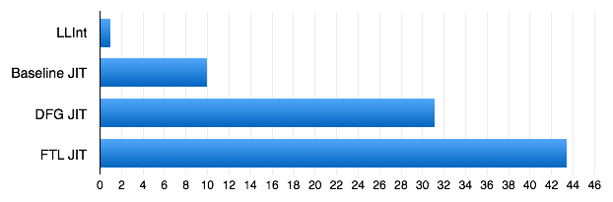
FTL JIT
Tiers speed-up
(OS simulation by Martin Richards benchmark)
Higher is better

Slide 12
FTL JIT
Previous levels optimizations
Aggressive C-like optimizations
Low Level Virtual Machine
Memory-to-Register
Instruction Combining
Global Value Numbering
Control Flow Simplification

Slide 13
FTL JIT
LLInt
100 x statement execution
6 calls
Baseline JIT
-1 000 x C
DFG JIT
-100 000 x C
FTL JIT

Slide 14
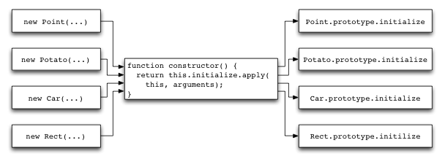
We recommend
Avoid polymorphic code
Use JS types (e.g. typed arrays)
Prototype.js
var Class = {
create: function() {
function constructor() {
this.initialize.apply(this, arguments);
}
return constructor;
}
}
var Person = Class.create();
Person.prototype = {
initialize: function(name) {
this.name = name;
},
say: function(message) {
return this.name + ': ' + message;
}
};
No need in Asm.js
Avoid enormous functions
Avoid complex recursions, try-catch

Slide 15
Thanks for your attention

